Slide 1

SAP BTP ABAP on Cloud / RAP Training
DAY-8
Anubhav Oberoy
www.AnubhavTrainings.com
Follow excellence with sheer passion

Slide 2


DISCLAIMER
The training content and delivery of this presentation is confidential, and cannot be recorded, or copied and distributed to any third party, without the written consent of Anubhav Trainings

Slide 3

01
Early Numbering
02
Static Feature Control
03
Dynamic Feature Control
04
Actions
Notes:
https://pixabay.com/photos/san-francisco-transamerica-pyramid-1633203/

Slide 4

Development Flow – Processor and Approver
Fiori App – Processor
Create, update, delete, copy travel
Fiori App – Approver
Display the travel request data
Service definition
Service Binding
Service definition
Service Binding
MDE for Processor Projection
MDE for approver Projection
BDEF Projection
For Processor
Expose what is needed by a processor role in company
Behavior Definition (BDEF)
Tell RAP framework regarding our operations which needs to be supported for BO (managed)
BDEF Projection
For Approver
Expose what is needed by a approver role in company
Business Object Projection
For Processor
30 fields to internet
Business Object (definition)
Includes the Travel, Booking and Booking Supplement CDS entities
100 fields
Business Object Projection
For Approver
25 fields
www.anubhavtrainings.com

Slide 5
Behavior Definition (BDEF)
Behavior definition describes the behavior of the business object in terms of what operations are allowed for our entire BO. If the BO consists of multiple entities (e.g. Travel, Booking, Booking Suppl), there is exactly one BDEF which exist for this business object.
The BDEF will have exactly same name as your root entity, you are not allowed to change the name. We can test our business object once the behavior definition is created. The RAP framework will auto generate all the necessary code behind the scenes to handle the CURD (Create, Update, Read, and Delete) operations on our BO.
Based on the BDEF, the RAP framework will decide whether it’s a managed or unmanaged scenario. In addition to CURD, we can also maintain the actions, determinations, prechecks, validations, draft availability, draft actions etc. as part of behaviour definition.
The name of BDEF is always same name as your BO.
https://help.sap.com/docs/ABAP_PLATFORM_NEW/fc4c71aa50014fd1b43721701471913d/761d389302e8463a9c3509907f22f22f.html?q=behavior%20definition#loio761d389302e8463a9c3509907f22f22f__impl_strict_transAct
Business Object
Travel(root)+Booking+Booking Suppl
Behaviour Definition
1 0..1
www.anubhavtrainings.com

Slide 6
Framework Generated IDs
The RAP framework will contain multiple framework generated values when data comes to us in our ABAP code or when we process the BO instance. All the framework generated parameters starts with %
%CID
During create mode the primary key of BO instance is not generated, until the save sequence is execute (like late numbering) like in our case the travel id is created after all the validations are passed. We have %CID also known as content id and is used in the OData request to bind the result operation to a name so that it can be referenced in another operation later. I sent a call from my laptop, one of the browser session, so if there is a issue, I only should get the error on my screen.
It is like a temporary primary key which is given by the RAP framework kept in the transaction buffer to track the user session or our BO instance. Later on once the actual key is generated, the %CID will act like a foreign key to associate with session and will sent back to RAP by us to inform RAP that which session does this operation belongs to.
%tkey
When we apply operations on our table like a action. We also receive a table key in our code, and based on that we will reply the RAP that a particular operation on the table was completed. If something goes wrong we will also inform the error to the RAP framework using this table key.
%key
For a single operation like Edit, Delete inside the object page, we will also receive the key of the object which we are editing or deleting.
www.anubhavtrainings.com

Slide 7
EML – Entity Manipulation Language
The EML is part of ABAP language that access to RAP BO. Because the consumption of business object via odata protocol requires a Fiori UI or Web API, the EML enables a type-safe access to business object directly. EML interacts with the business object entities (single entity – travel) to perform all the entity operations.
EML can be used to provide behaviour for business object. For example, we can implement an action that first triggers a create and then a update using the EML. It is one of the best way to consume our RAP framework and Business object using plain ABAP code w/o creating any special API or service.
Use cases:
Consumption of RAP functionality in Plain ABAP
Testing purpose
Build special business logic
Generate test data
For integration with classic code
www.anubhavtrainings.com

Slide 8
Syntax for EML
Read operation
Read from Root entity and by the key
Read the root entity with its composition child (travel and booking together)
A read operation always either returns a RESULT 🡺 capture in a internal table
OR returns an error table called as FAILED 🡺 capture in a internal table
AND returns an table of messages as REPORTED 🡺 capture in a internal table (other messages)
If we use second option we can specify the associated entity using \_AssociationName
READ ENTITIES OF RootEntityName
ENTITY EntityAlias FROM keys ---(primary key value)
RESULT lt_result
BY \_Composition FROM child_keys
RESULT lt_result_child
FAILED lt_failed
REPORTED lt_reported.
www.anubhavtrainings.com

Slide 9
Update and Delete operations
MODIFY ENTITY OF EntityName AS alias_name
ENTITY EntityName
CREATE FROM lt_create
UPDATE FROM lt_update
DELETE FROM lt_delete
CREATE BY \_AssociationName FROM lt_instance_cba
RESULT lt_result
FAILED lt_failed
REPORTED lt_messages
MAPPED lt_mapped.
www.anubhavtrainings.com

Slide 10

Class Pool
Local types for global classes are the bunch of data types and classes with a single global class. It can be defined to ensure better structure of implementation of global class.
Imagine we are developing an application which requires so many classes, each class will have a few methods only.
More number of classes in our application will cause excessive modularization and confusion among our developers.
More number of global classes, will increase the chance of code being exposed to other programs which we want to keep as private.
We need a mechanism which is a good trade-off between modularization, reuse and maintenance w/o exposing too much functionality to the caller of our application code. We should never have too many objects, especially when each class have just a few methods.
At times, we need to add only a few functions inside a class but likewise we need so many many classes, managing these classes and their lifecycle including transport will be a big task inviting maintenance also for future and making over all design very complex.
www.anubhavtrainings.com

Slide 11
Behavior Pool
The transaction behavior of a BO in the context of RAP is implemented in one or more than one global class.
These special classes are dedicated only to implementing the business object behavior and called as behavior pool.
You can assign any number of behavior pool to behavior definition (a 1:n relationship)
Within a single global class, we can define multiple local classes that can handle the business object behavior.
The global class is just like a container and basically empty while the actual behavior logic is written inside the class pool.
We can assign any number of behavior pool to behavior definition (1:n). This allows us to distribute our implementation across multiple units. This is called contribution design pattern. Which allow team to work in parallel on multiple tasks.
A behavior implementation class always inherits from cl_abap_behavior_handler class.
Travel
(root)
Behavior pool
Helper classes
Booking
Behavior pool
Booking Suppl
Behavior pool
www.anubhavtrainings.com

Slide 12
Implicit Response Parameters
When implementing a BO contract, we can make use of implicit parameters. These parameters do not have FIX data type, instead they are assigned by the compiler with the type derived from BDEF.
The implicit parameters can be declared explicitly as CHANGING parameters in the method signature of the class using generic type
DATA: lt_imp_param FOR <OPERATION> entity.
Data : lt_mapped FOR CREATE BO-Travel.
FAILED
This is an exporting parameter which is defined as nested table contains one table for each entity. The failed table includes the information for identifying the data set where the error occurred. It has %CID, the ID of the BO instance, %FAIL which has the reason of failure. If_abap_behv=>t_failinfo
REPORTED –
This is an exporting parameter which is defined as nested table contains one table for each entity.it includes the instance specific messages.
%CID, ID of the relevant BO, %MSG with the message interface, %ELEMENT
MAPPED – Only during Create/Update operation
This is an exporting parameter which is defined as nested table contains one table for each entity. The mapped parameter provide the consumer with ID mapping information. They include information about key values were created by the application for given content id. The BO runtime passes the created key values in any subsequent call in the sample request.
%CID and %KEY
www.anubhavtrainings.com

Slide 13
BO instance features
Early numbering
It allows a managed numbering for bo instances during creation process. Like in ABAP we use sequence numbers (SNRO) to auto generate primary keys, here in RAP we can use early numbering. It can be handled for all the entities. For this we need to implement the logic in RAP BIMP.
Every assigned key must be unique, otherwise the instances will be rejected by the database which will result to dump. We will be reusing a SNRO sequence already created by SAP in the system.
www.anubhavtrainings.com

Slide 14
Sequence of calls
Fiori app
OData
RAP
BIMP
HANADB
entities
FAILED, MAPPED, REPORTED
www.anubhavtrainings.com

Slide 15
Sequence of calls
Fiori app
OData
RAP
BIMP
HANADB
entities
FAILED, MAPPED, REPORTED
www.anubhavtrainings.com

Slide 16
Exercise
Assign the booking Supplement ID automatically during creation with early numbering.
www.anubhavtrainings.com

Slide 17
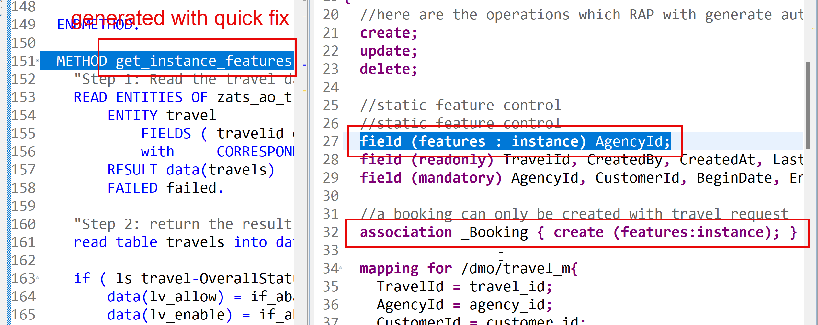
Feature Control
As an application developer we want to determine which entities of our BO needs to allow create-, update-, delete- operations. Apart from that which properties of BO are allowed to be mandatory, read only, creatable, updatable. We can also control the availability of our data actions.
In RAP, feature controls are of 2 types:
Static feature control – are specified at the level of behavior definition only. Statically declared and easy to implement.
Dynamic feature control – complex to implement for more complex requirements. They require a mandatory implementation in BIMP class. We use keyword features:instance
www.anubhavtrainings.com

Slide 18
Data Actions in RAP
In the context of RAP, an action is a non-standard operation that change the data of a BO instance or create new BO instances. They are self implemented operations. There are two main categories of data actions can be implemented in RAP:
Non factory action: Defines a RAP action which offers the non-standard behavior and implement custom logic in handler with MODIFY clause. A non factory action can be of 2 sub types (change a property of a record)
Static – they are not bound to any instance, they are generic and can be applied to all instances, like we want to change the booking fees for all travel request as fix price during promotion period.
Instance – An action that, by default relates to a BO RAP entity instance and changes the state of BO instance. E.g. like approve or reject a travel request where user choose a instance which they want to work with.
Factory Action – A factory action used to create new BO instances. A factory action can be instance-bound (default) or static.
Instance – that copy specific values of an instance and create new instances based on copied data
Static – can be used to create instances with prefilled default values
www.anubhavtrainings.com

Slide 19
Determination
A determination modifies instance of business object based on trigger condition. Trigger condition can be modify operations such as create, update, and delete and modified field. There are 2 types of determination
on modify – will be triggered before save whenever trigger condition is met e.g. when I change booking fee
on save – will always trigger at the time of save
Steps
Add the code for defining the determination in behavior definition, we want to do it in reusable way
Use quick fix to generate the code for determination
Define a structure where we can store all the booking fees and currency code
Read all travel instances, subsequent bookings using EML
Total all booking and supplement amounts which are in common currency
Delete the values w/o any currency
Loop at all amounts and compare with target currency
Perform currency conversion
Put back the total amount
Return the total amount in mapped so the RAP will modify this data to DB
www.anubhavtrainings.com

Slide 20
Validations
Many times we would like to perform business specific checks in our application, The rap framework is only responsible to perform CURDQ operations. It does not know what are all the business rules applies to our code.
If we return FAILED and MESSAGE then the RAP will terminate the update/create and shows the message to the user on Fiori App.
www.anubhavtrainings.com

Slide 21
www.anubhavtrainings.com
Thank You
End of Day 7
www.anubhavtrainings.com

Slide 22


We’re committed to empower you to be
#FutureReady
through powerful training solutions.
We build the workforce of the future.
250+
Corporate Clients
30,000+
Learners Trained
25000+
Learners Placed
FREE WEBINARS
Sign up for free webinars with industry experts every fortnight!
Enroll Now!
Contact us today!
https://anubhavtrainings.com

